Slide 1
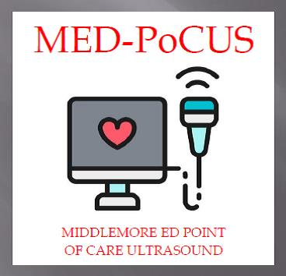
uLTRASOUND
www.mmheme.org

Slide 2
PoCUS?
Specific training and credentialing is required for the use of ultrasound in ED.
In general the use of point of care ultrasound (PoCUS) in ED is in a focused fashion:
That is it is utilised in a specific defined clinical setting to recognise a narrow list of potential diagnoses. Ideally this should answer a binary question ie. is there a pericardial effusion?
Further advanced training and qualification may allow the user to perform further limited studies or rarely a specific comprehensive study.

Slide 3
Bio effects and safety
ALARA principles

Slide 4
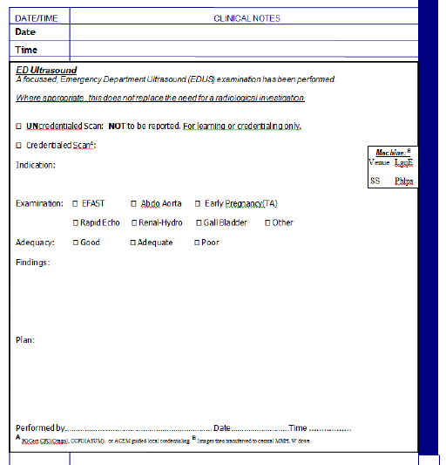
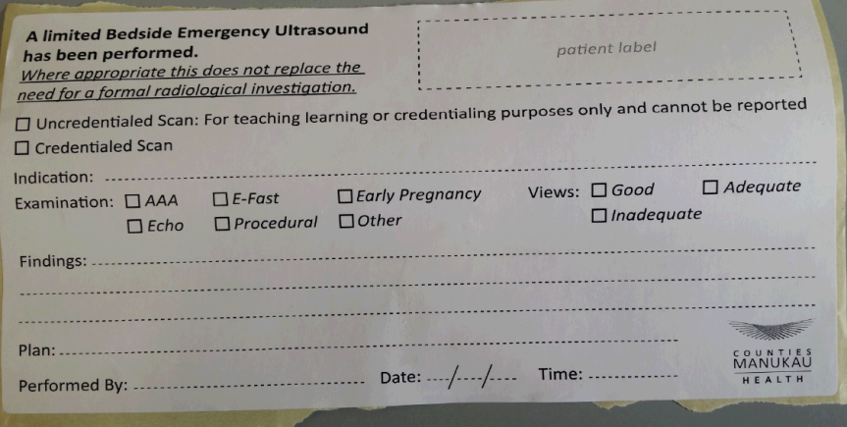
Documentation
ED Ultrasound (intranet)
https://cmhealth.hanz.health.nz/Emergency%20Department/WBDIPN/Pages/EDUltrasound.aspx

Slide 5
Qpath
Cloud Storage system
Logins
How to use and manipulate
How to complete QA submission

Slide 6
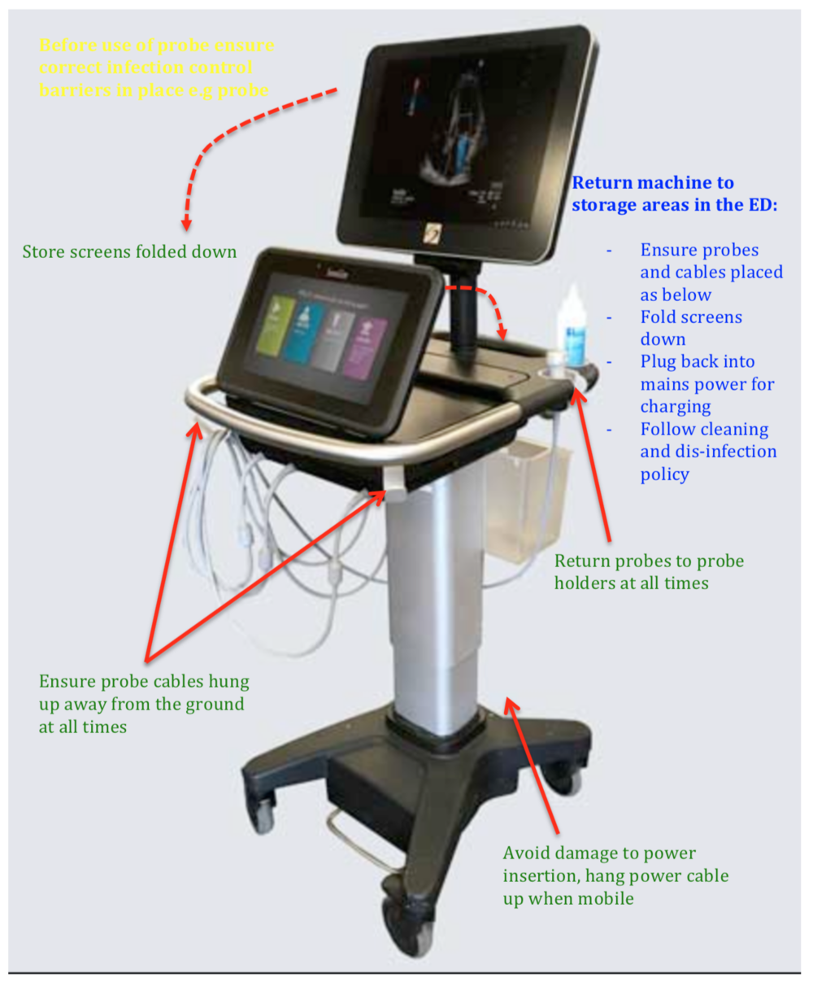
Machine Care

Slide 7
Machine Infection Control
PROBE COVERS
Sterile probe cover and sterile gel are required in any circumstance of:
Any needle guided procedure
Any external scan in presence of non-intact skin, or blood/body fluid contamination

Slide 8
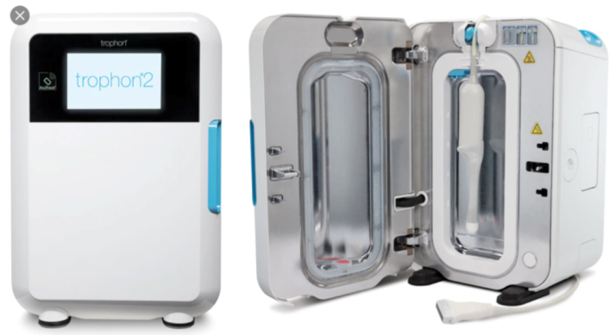
DISINFECTION- LLD and HLD
Low Level Disinfection (LLD) before and after all scans should be undertaken with disinfectant wipes (not with alcohol or virkon based wipes):
High Level Disinfection (HLD) should occur if any breech in probe cover occurs or contact of the probe with any bodily fluid:
HLD is carried out using the ED based Trophon device which utilises Hydrogen Peroxide for a high level sterilisation.

Slide 9
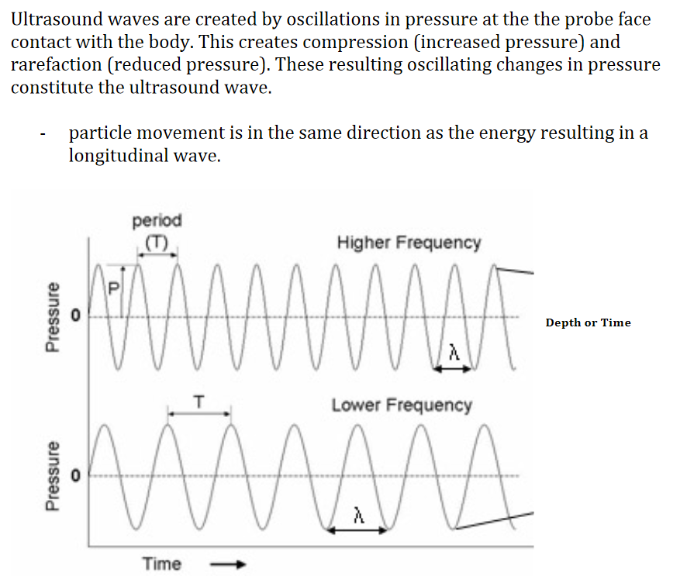
Basic Ultrasound Principles

Slide 10
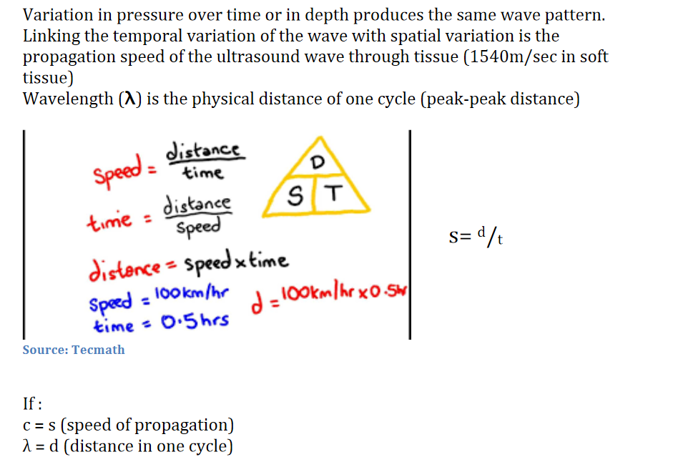
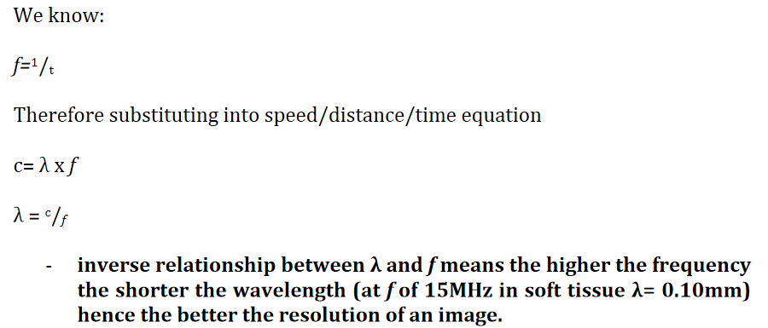

Slide 11
Ultrasound Tissue Interaction

Slide 12
Attenuation

Slide 13
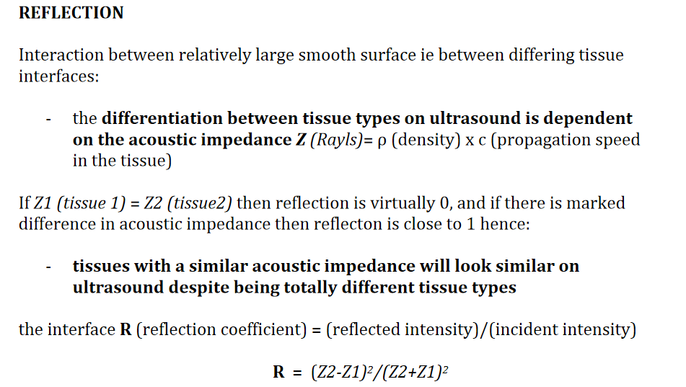
Reflection

Slide 14
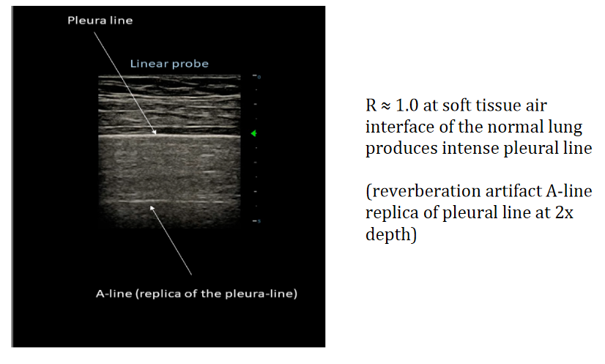

Slide 15
Scattering

Slide 16
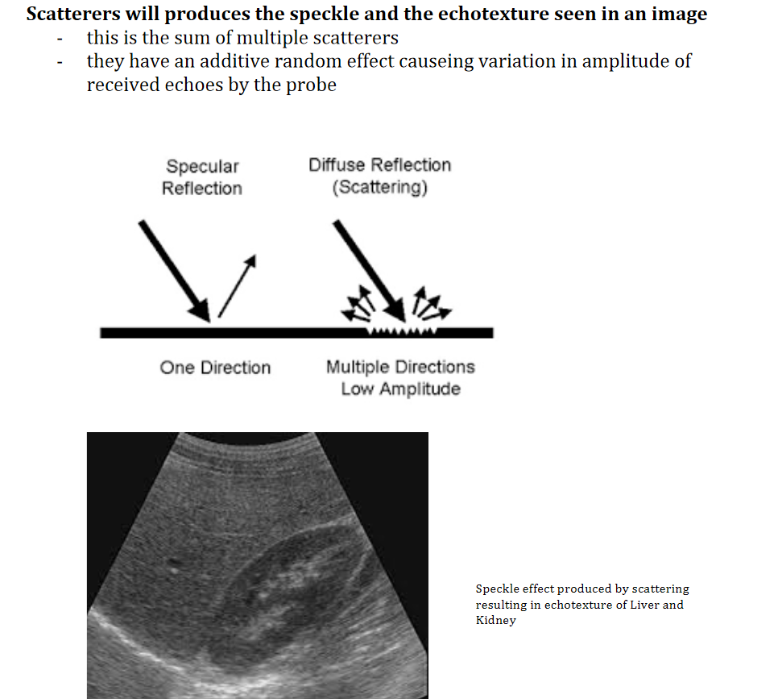

Slide 19
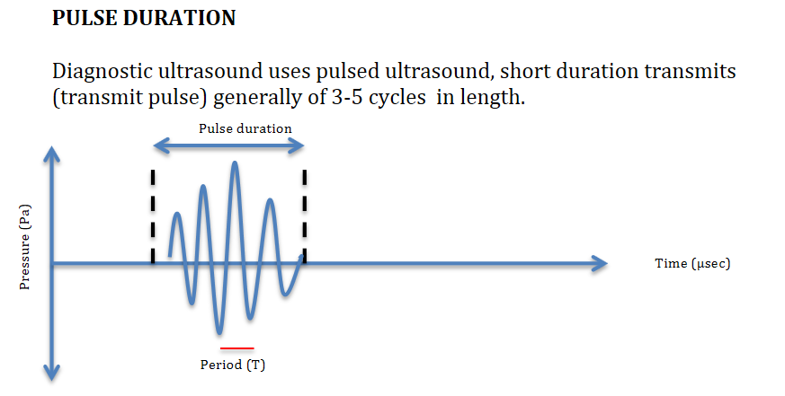
Pulsed Ultrasound Principles

Slide 21
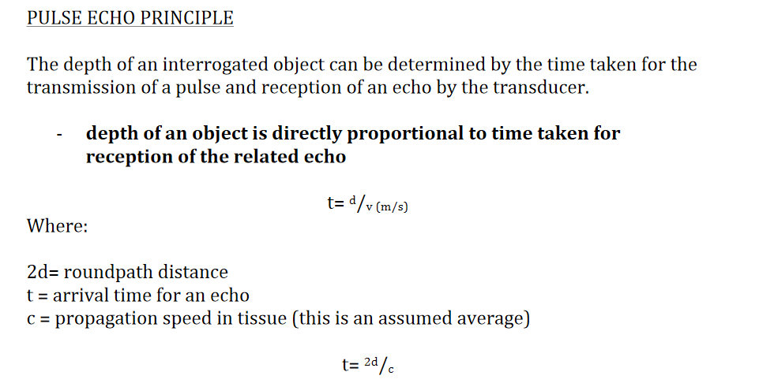

Slide 22
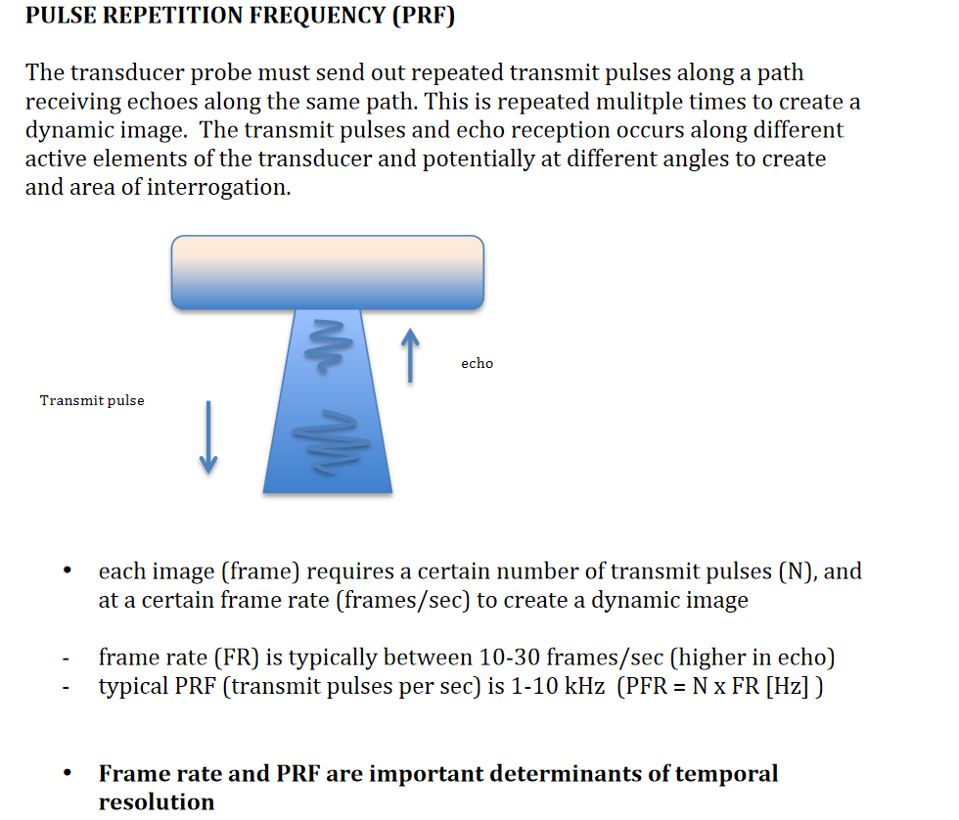

Slide 25
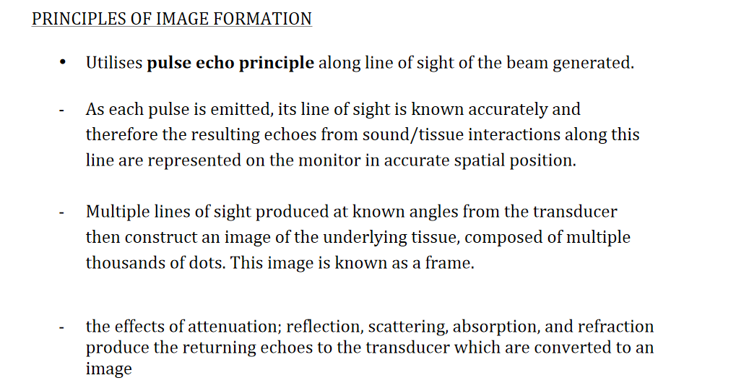
Principle of Image Formation

Slide 26
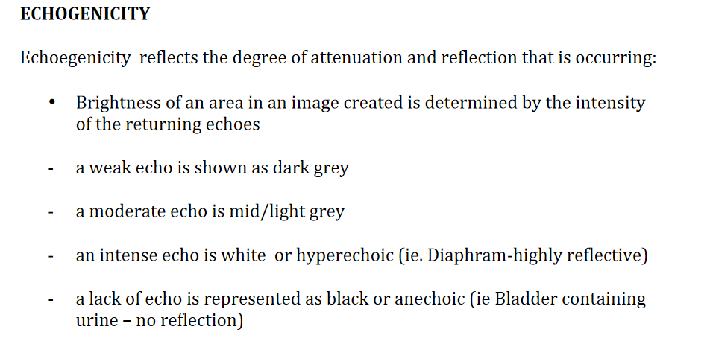
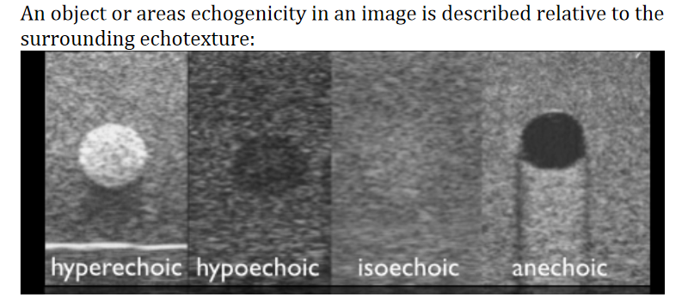

Slide 27
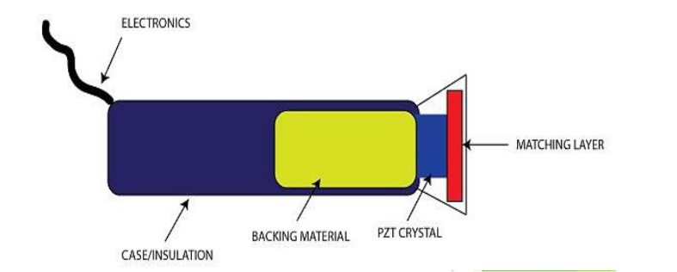
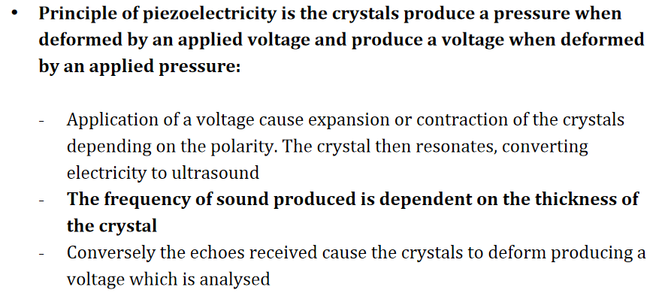
Transducers – Piezoelectric Effect

Slide 29
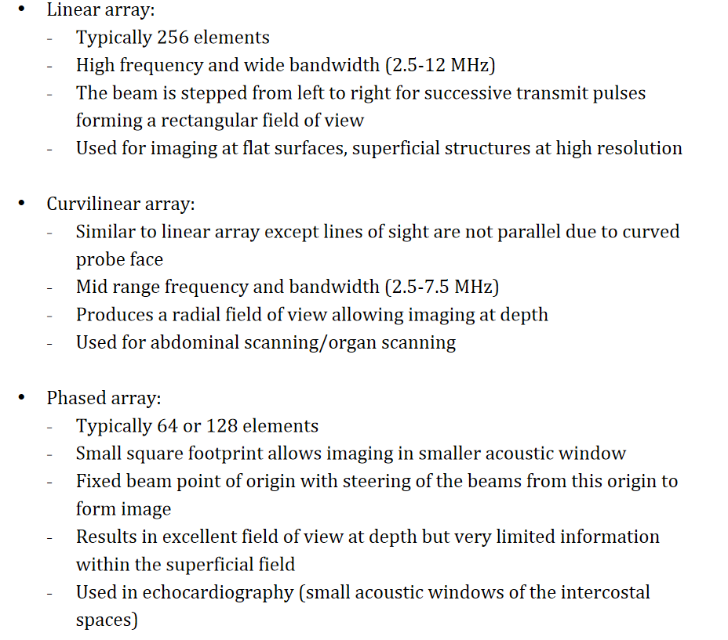
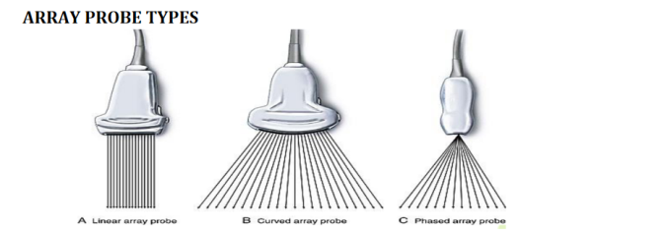

Slide 30
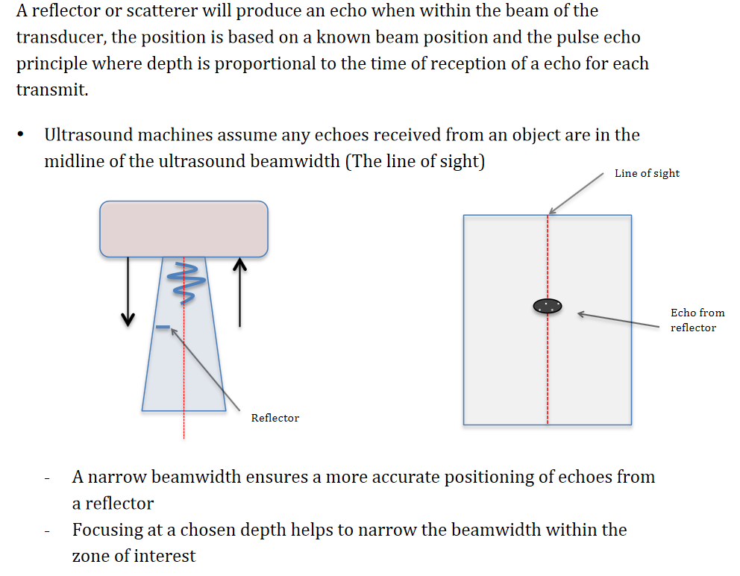
Beamwidth, Focusing and Lateral Resolution

Slide 31
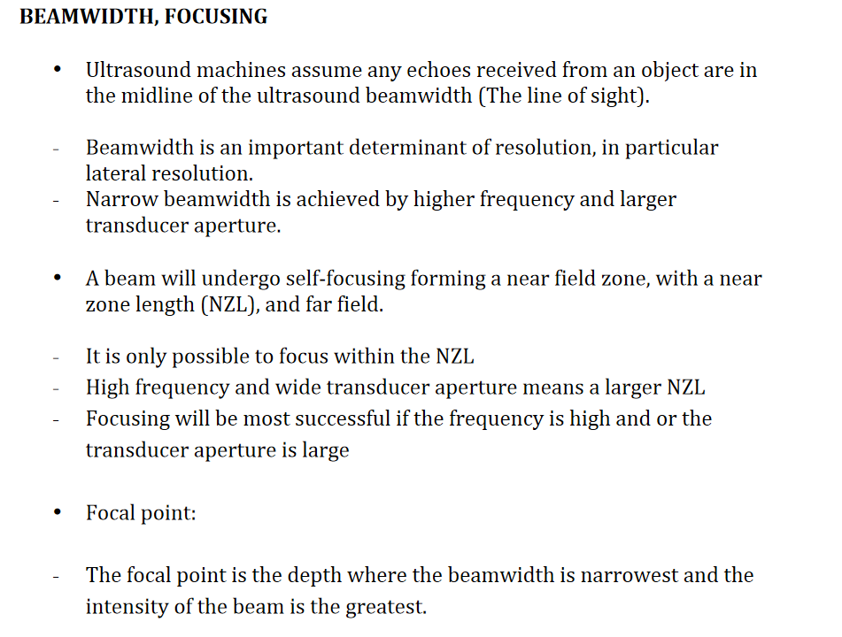
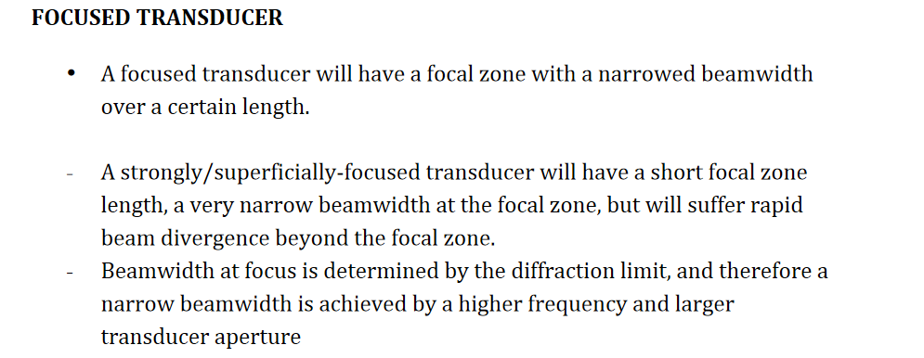

Slide 32
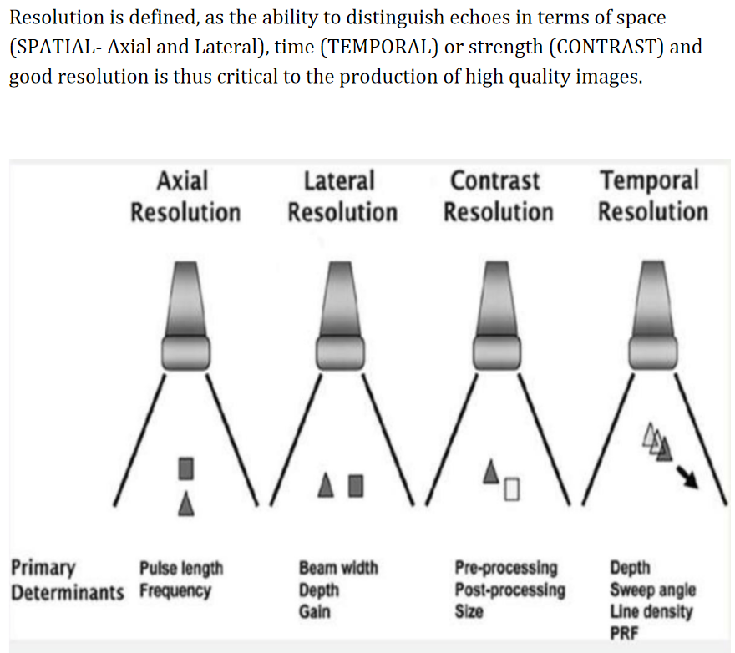
RESOLUTION

Slide 33
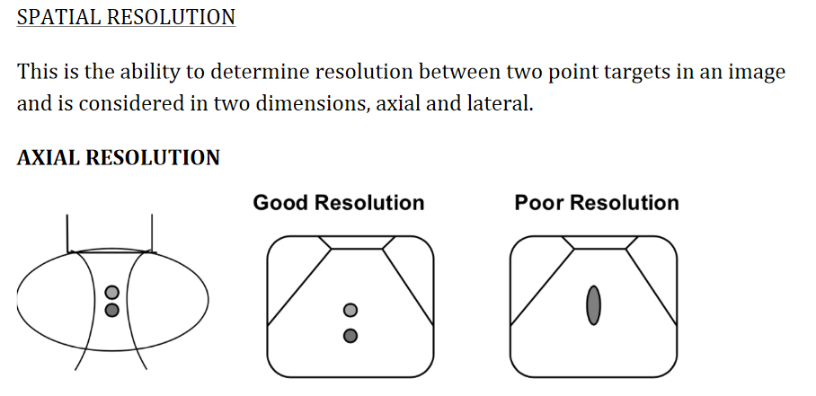

Slide 34
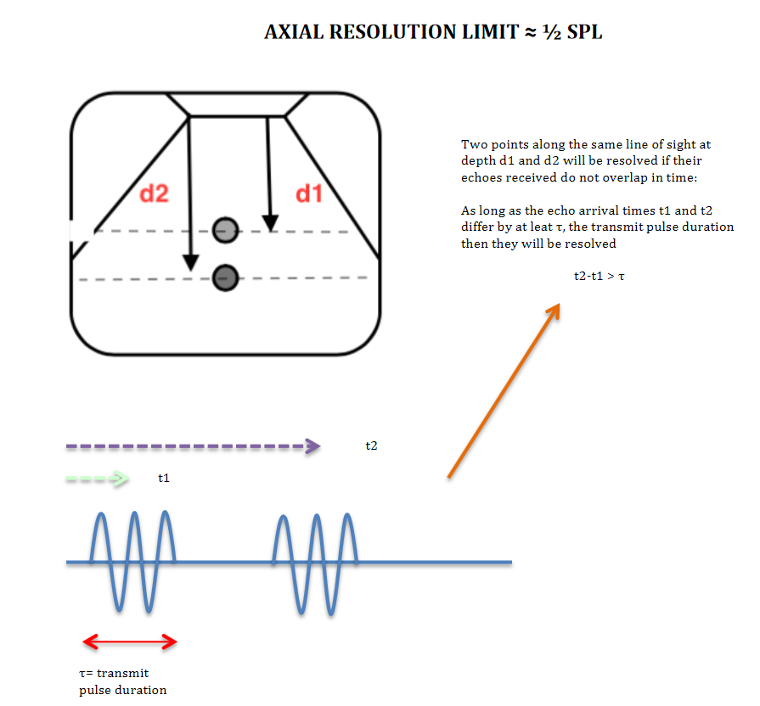

Slide 35
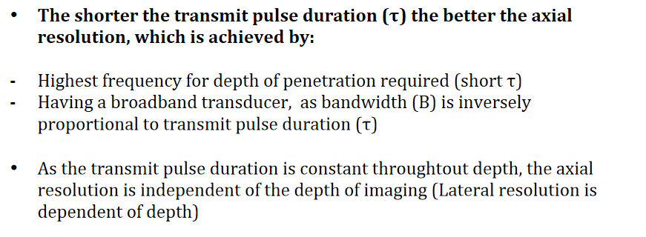
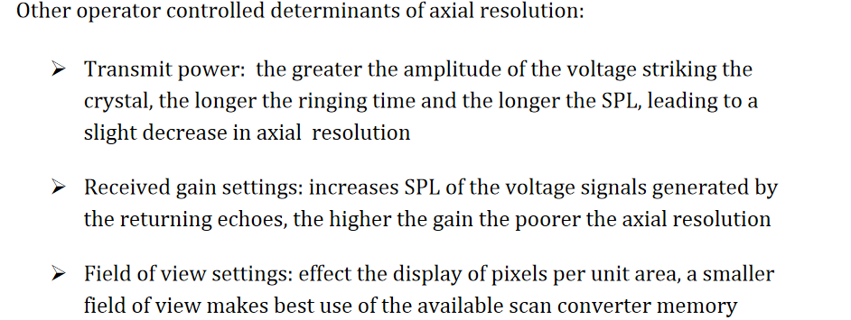
To achieve the best axial resolution

Slide 37
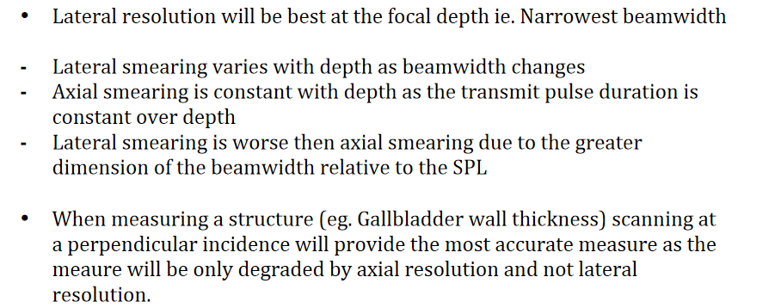

Slide 38
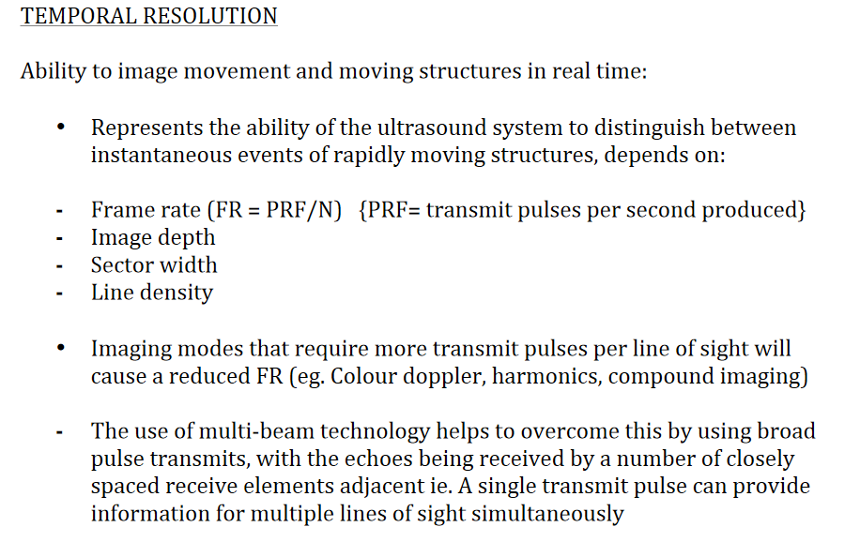

Slide 40
ARTIFACTS

Slide 41
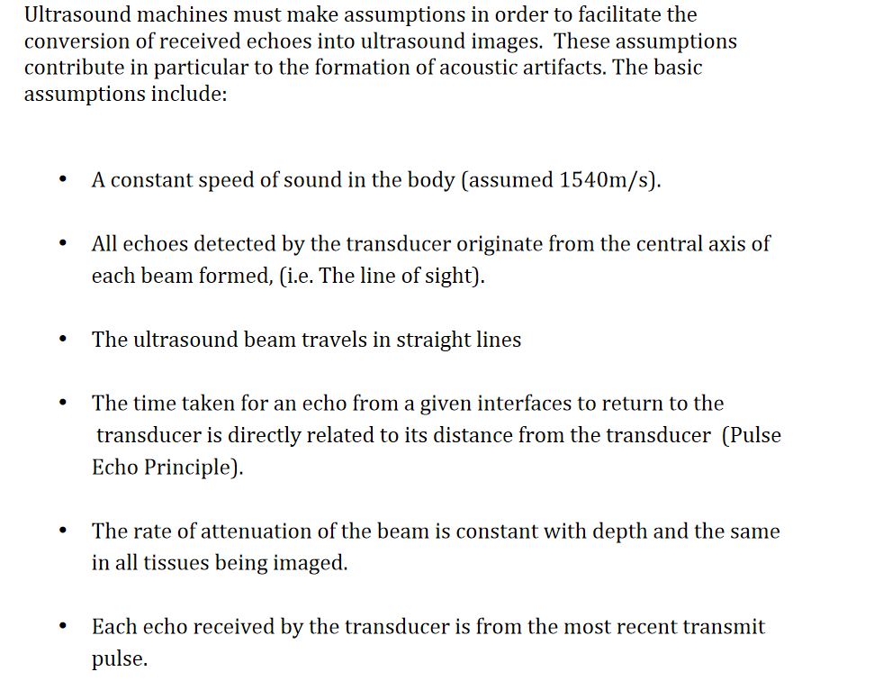

Slide 42
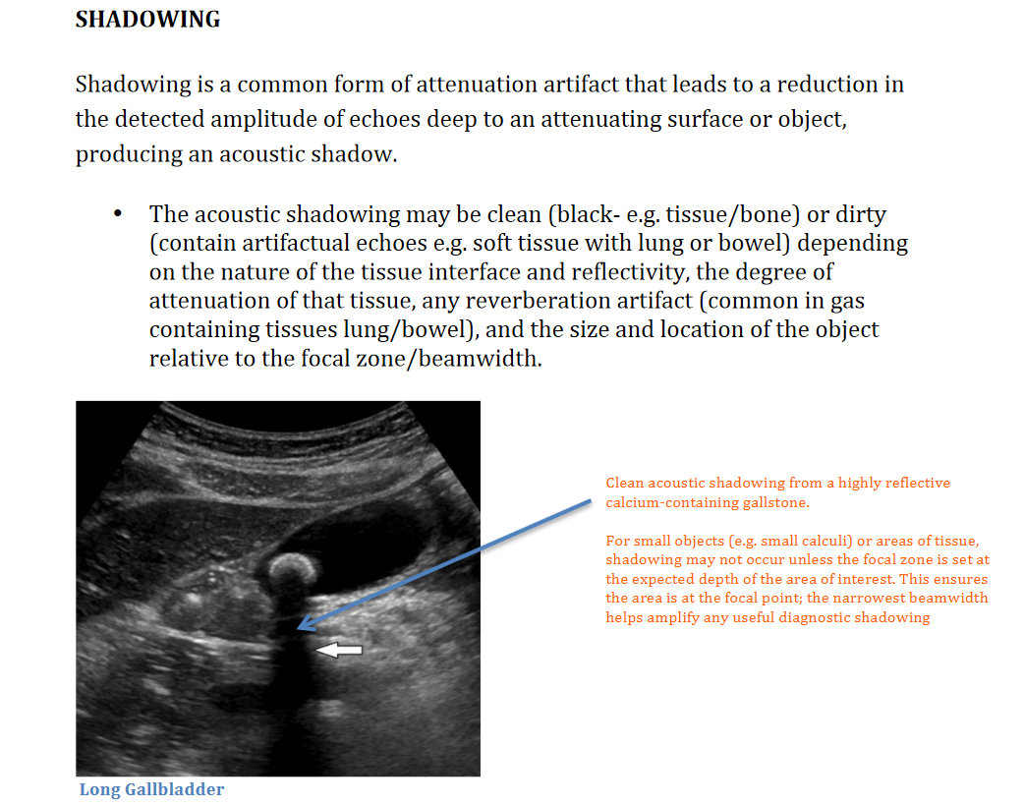
Attenuation Artifacts

Slide 43
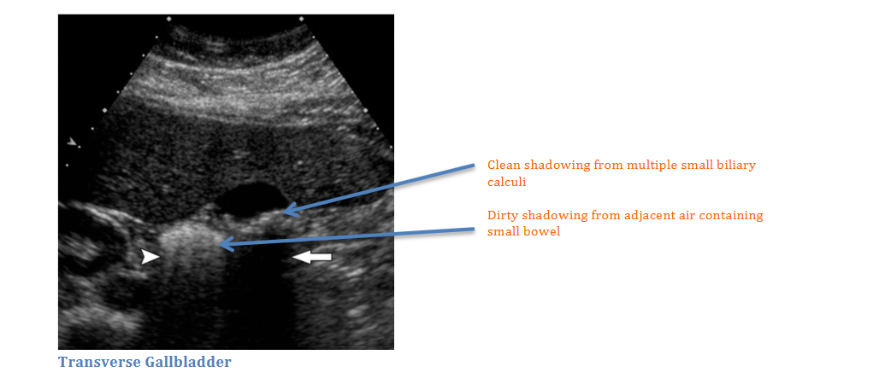

Slide 44
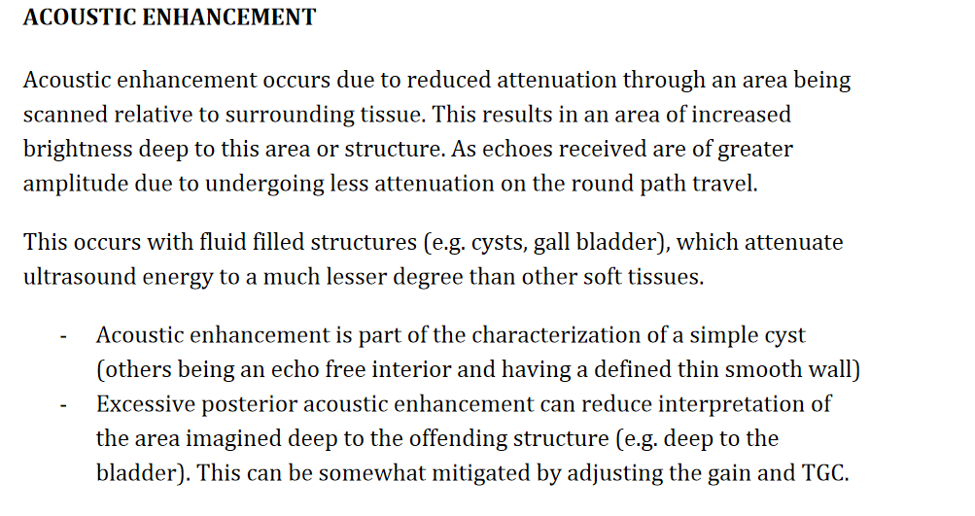

Slide 45
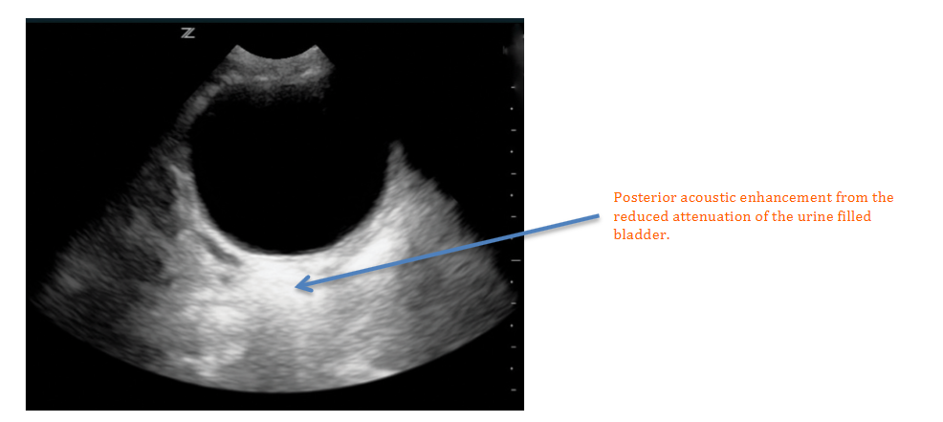

Slide 46
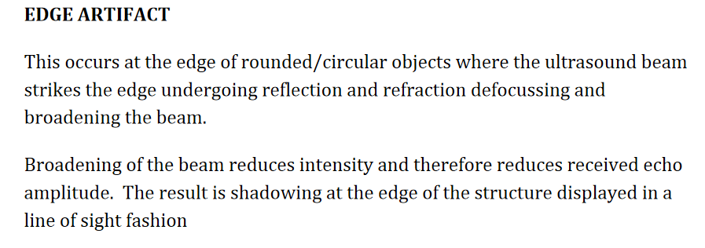

Slide 47
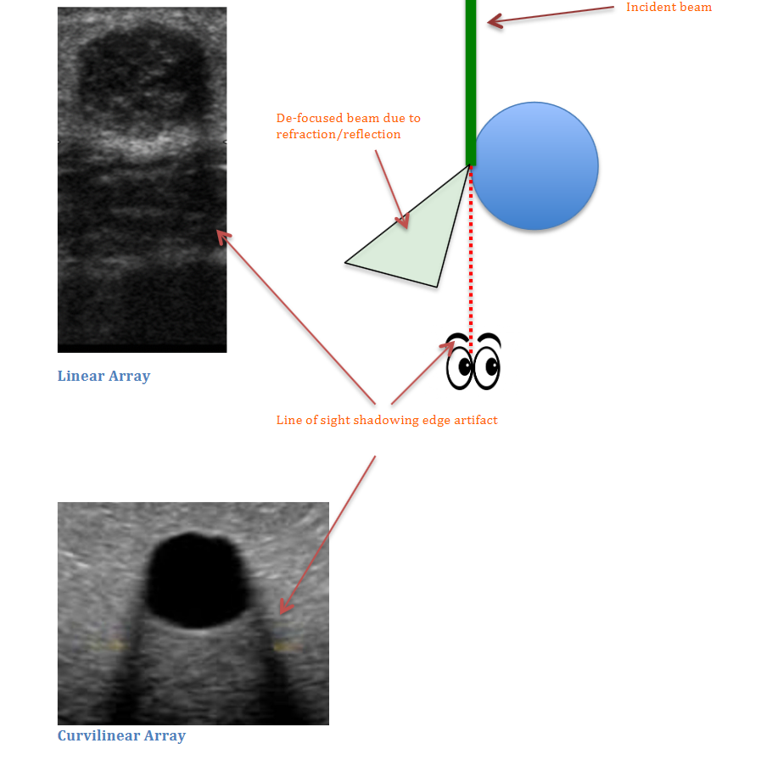

Slide 48
Depth Artifacts

Slide 49
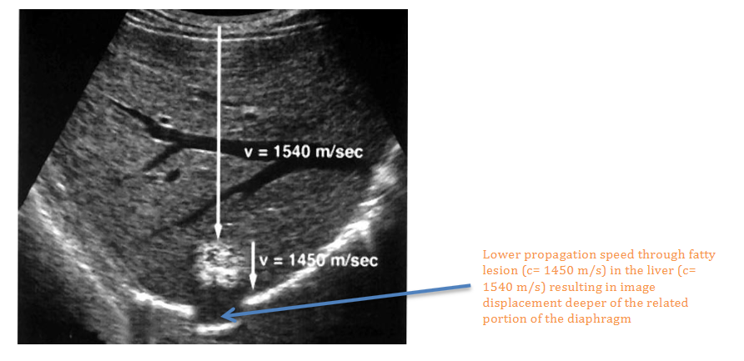

Slide 50
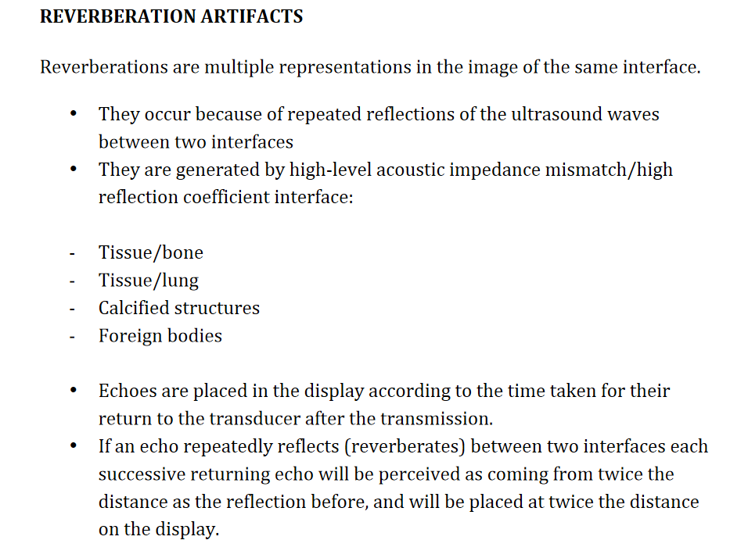

Slide 51
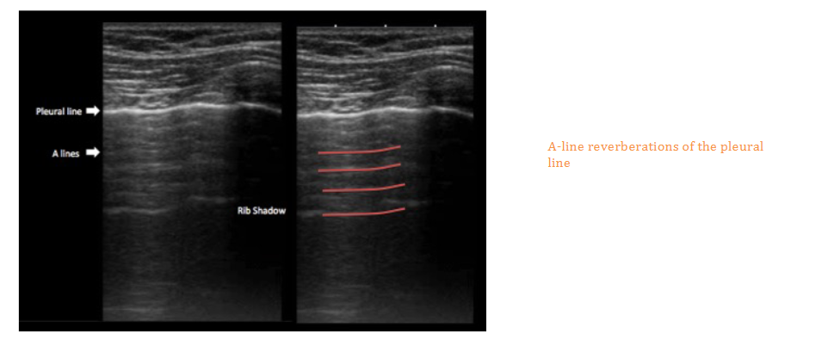
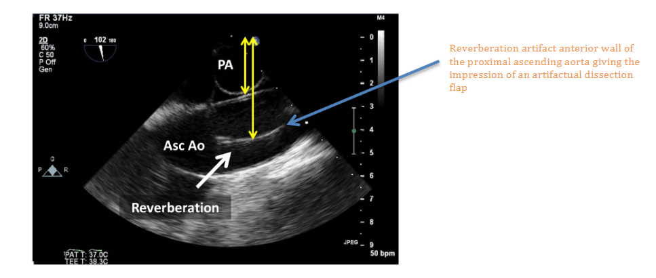

Slide 52
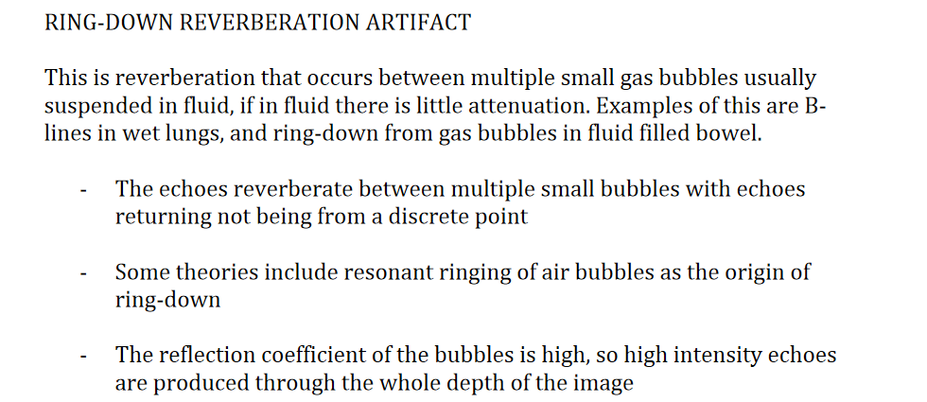
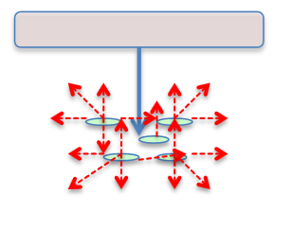

Slide 53
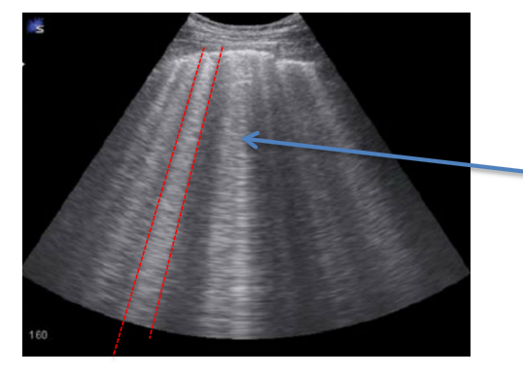
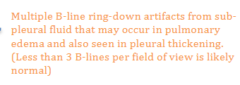
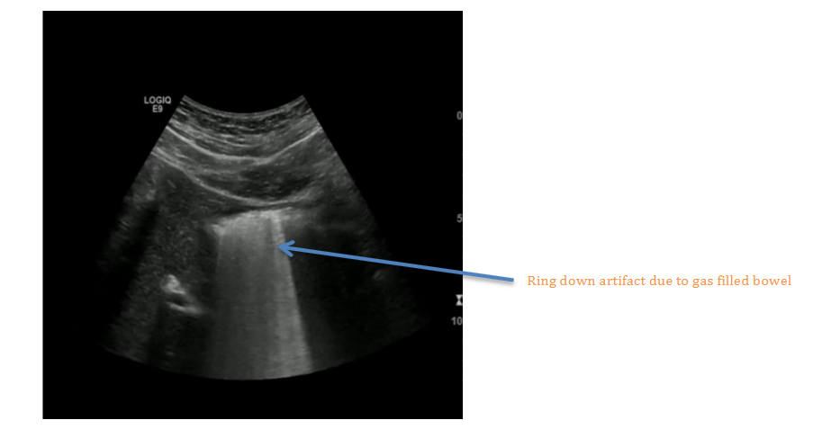

Slide 54
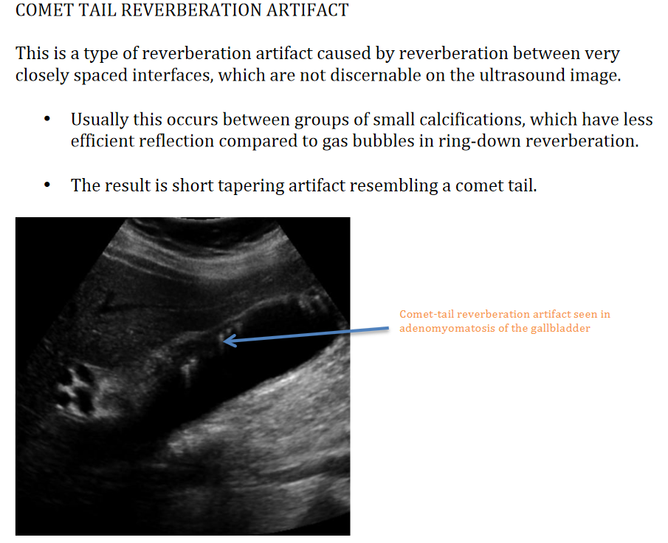

Slide 55
Beamwidth Artifacts

Slide 57
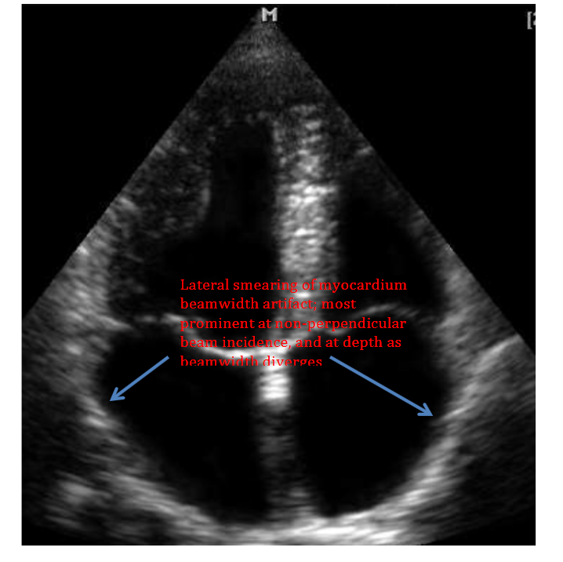

Slide 58
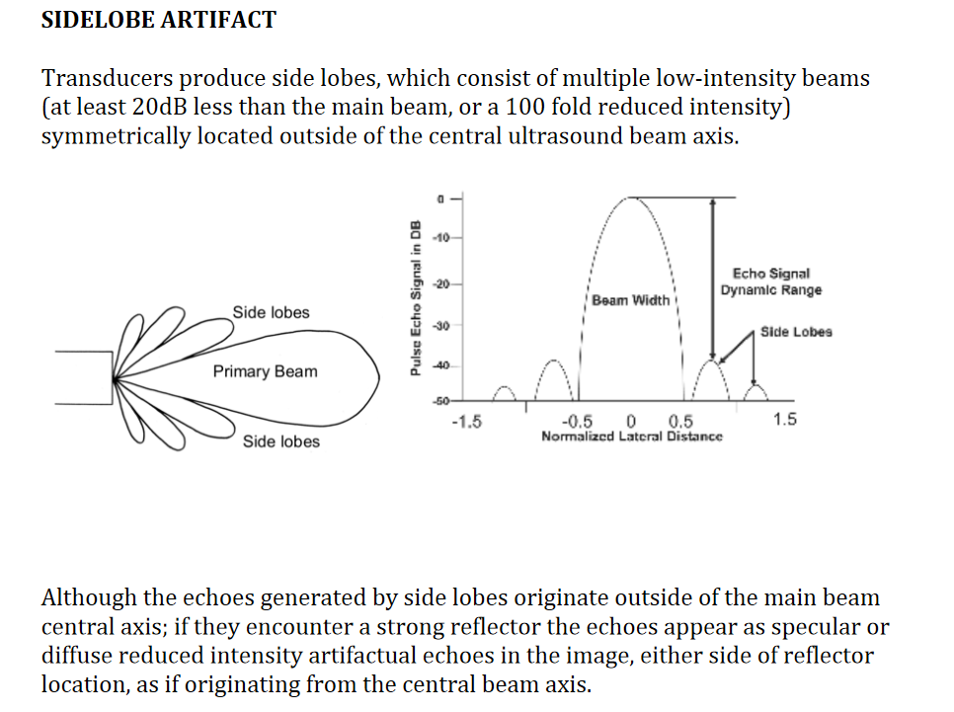

Slide 65
KNOBOLOGY

Slide 66
DEPTH
Ensure your depth is adequate and the area of interest in your image is optimised. Generally starting with a slightly deeper field of view and then reducing the depth is a practical way to ensure you don’t miss anything of interest (e.g. pericardial effusion in cardiac Parasternal-Long-Axis view)
Reducing depth:
Improves image resolution
Makes the area of interest physically easier for you to visualise
Helps make any measurements more accurate
A general rule is that the area of interest should take up about 80% of your screen

Slide 67
GAIN and time gain compensation(TGC)
Gain effectively changes the brightness of the image. It is a pre-processing function amplifying the received transducer signals. It does not affect power output from the probe, as such there is no change in intensity of tissue exposure for the patient.
Depending on the particular machine the gain can be adjusted in different ways:
Overall GAIN
Near and Far-field GAIN (Sonosite X-Porte)
Time Gain Compensation (TGC)

Slide 68
Overall GAIN should be adjusted so that grey-scale image contrast resolution is optimal giving a smooth echotexture:
Under-gained the image will be too black
Over-gained the image will be too white
Excessive gain can result in loss of subtle differences in echo texture, and also increased artifactual echoes.

Slide 70
TGC function changes the gain at varying depths in the field of view.
Typically this utilised to increase the receive amplification for weak echoes from depth, and reduce those from strong unwanted echoes that are usually from superficial structures or strong reflectors.
It can also be used to reduce posterior acoustic enhancement deep to fluid filled structures

Slide 72
FOCUS
The focus is where the ultrasound beam is at its narrowest and the best spatial resolution will occur:
Some machines have auto focus whilst others will allow the user to manipulate the focal depth. The focus is usually indicated by an arrow or triangle marker on the left of the screen.
The focus should be placed at the depth of interest in the image, or just deep to it:
spatial resolution will be maximised
improved image clarity
more accurate caliper measurements

Slide 74
ZOOM
Write zoom (pre-processing function):
The write zoom is a dynamic function that allows the user to select an area of interest within the image and zoom in.
Enlarges small areas of interest e.g. early pregnancy
Makes it easier to measure small luminal distances e.g. CBD
Image resolution is maintained
Improved frame rate as reduced number of lines of sight

Slide 75
Othe Important Topics
PROBECRAFT
BIOEFFECTS AND SFAETY
LABELLING AND DOCUMENTATION

